Slide 1

Enterprise Procurement & Vendor Management System
Isaac Tai (Hsuan Hung Tai)
Peter Chen (Qiyao Chen)
Alvin Lin (Wei Hong Lin)

Slide 2
Project Goal
Build a Java-based Enterprise Procurement & Vendor Management System that simulates the procurement workflow in a large tech enterprise. The system supports internal collaboration and external vendor interactions, highlighting the complexity of cross-department and cross-enterprise communication.
Notes:
So for our project goal, we want to build a procurement management ecosystem to simulate the procurement workflow.
The workflow include the internal collaboration between different departments and external interactions between different enterprises.

Slide 3
Problem Statement
Procurement in large companies involves multiple stakeholders (e.g., IT, Finance, Warehouse, HR, external vendors) and is often slowed by the lack of unified workflow systems.
Our project aims to address this by creating an integrated, role-based platform that increases efficiency, traceability, and transparency across the entire procurement lifecycle.
Notes:
The main problem we want to solve is that
in large company, a procurement flow usually involved in many roles, like IT, Finance, Warehouse and external vendors
so if there is no unified workflow, it usually takes a lot of time to complete a procurement
so, we have designed an integrated role-based system to increase efficiency.

Slide 4

Technologies Used
Frontend/UI
1
2
Backend
Java Swing
Java + Node + Express
Email Service
5
3
Database
Java Mail API for notification
MongoDB
4
Tools
NetBeans, MongoDB Compass, Postman
Notes:
And we have used five techniques including swing UI, java, node and express for backend api server
Mongo DB for database, and use postman to test our api
Also we use email service to implement the notification function

Slide 5
Core Features
Centralized dashboard with role-specific views
Full procurement lifecycle:
PR → RFQ → Quotation → Contract → PO → Delivery
Vendor quotation comparison and approval flow
Contract/legal review by internal departments
Email notifications for shipment updates
Delivery status tracking with confirmation from warehouse
Warm Note:
• PR = Purchase Request
• RFQ = Request for Quotation
• PO = Purchase Order

Slide 6
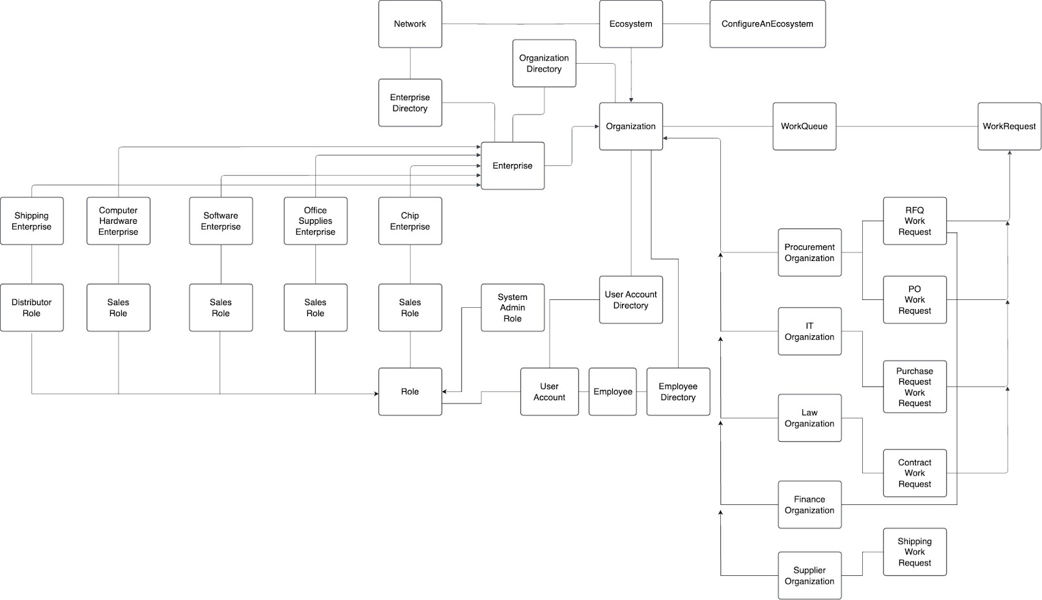
High-Level Component Diagram

Slide 7
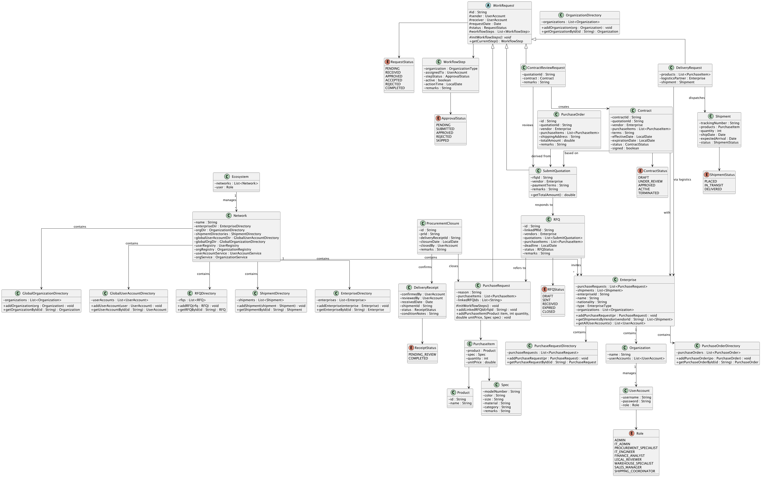
UML Class Diagram

Slide 8
Advanced Features
Email Notification: 'Your order is on the way' sent to buyer & vendor after shipment.
API: Handles backend logic and MongoDB data operations.

Slide 9
Sample Use Case
1. IT creates a PR
2. Procurement sends RFQ to vendors
3. Vendors submit quotations
4. Procurement selects quotation
5. Finance review quotation budget
6. System generates PO
7. Vendor ships via logistic
8. Warehouse confirms delivery
9. Request marked complete

Slide 10
Thanks!
Questions?

